Slide 1
Lecture 8: Views of Language Acquisition and Learning in Foreign Language Didactics

Slide 2
Main issues of this lecture
The source of language learning theories.
Principles of Behaviourism.
Principles of Mentalism (Chomsky).
Principles of Cognitivism.
Principles of Constructivism.

Slide 3
Scientific fields related to learning and language learning (1/2)
Psychology: a diverse area of study which involves, amongst other things, the study of how humans learn and how they make sense of the world.
Psycholinguistics: involves the study of a) the mental processes that a person uses in producing and understanding language and b) how humans learn language (the study of speech perception, the role of memory, concepts and other processes of language use).

Slide 4
Scientific fields related to learning and language learning (2/2)
First language acquisition is an area of psycholinguistics which focuses on how children learn their mother tongue.
Second language acquisition is an area of applied linguistics and studies the processes by which people develop proficiency in a second or foreign language. These processes are investigated with the expectation that this information may be of use to language teaching.

Slide 5
Behaviourism: Main Principles (1/3)
Main protagonists: Ivan Pavlov, John Watson, Edward Thorndike, B.F. Skinner.
Learning happens when a correct response is demonstrated following the presentation of a specific environmental stimulus.
Learning is changed behaviour.

Slide 6
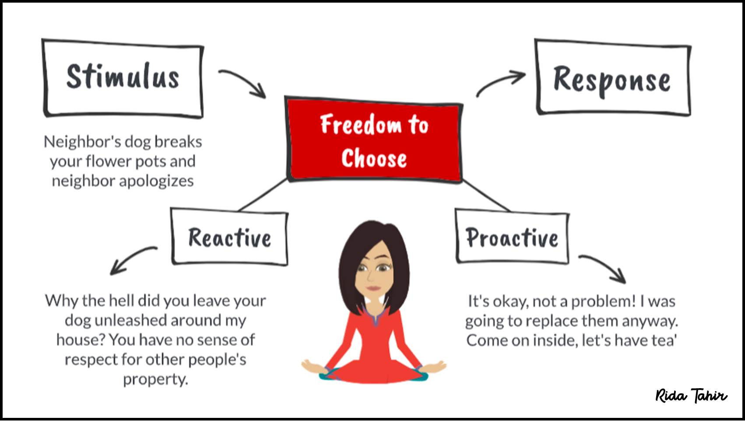

Slide 7
Behaviourism: Main Principles (2/3)
Conditioning: Learning is seen as a process of developing connections between a stimulus and a response. This process is called conditioning.
Habit formation: An individual responds to a stimulus by behaving in a particular way. If the behaviour is reinforced (i.e. rewards or punishment) then the likelihood of that behaviour occurring on a subsequent occasion will be increased or decreased. As the behaviour is reinforced, habits are formed.

Slide 8
Behaviourism: Main Principles (3/3)
Importance of environment: Learning is a result of environmental rather than genetic factors. The child is born as a clean slate and the environment writes its messages on this clean slate.

Slide 9
Behaviourism and foreign language teaching (1/4)
It had a powerful influence on second and foreign language teaching between the 1940s and the 1970s.
Influenced the development of the audiolingual method.
Instruction is to elicit the desired response from the learner who is presented with a target stimulus.
Student as passive receiver of information memorized dialogues and sentence patterns by heart.

Slide 10
Behaviourism and foreign language teaching (2/4)
Based on rewards and punishments.
Responsibility for student learning rests squarely with the teacher.
Lecture-based, highly structured.
Primacy of speech: considers speech as primary partly because it is the first medium that the child masters. Skills are taught in a specific order: Listening and speaking then reading/writing.

Slide 11
Behaviourism and foreign language teaching (3/4)
Stimulus-response-reinforcement: Learners are taught the language in small, sequential steps (structures and then sentence patterns). A small part of the language is presented as a stimulus, to which the learner responds by repeating or by substituting. This is followed by reinforcement by the teacher. By repeating the learner develops habits Learning a language is seen as acquiring a set of appropriate mechanical habits and errors are frowned upon because they lead to the development of “bad” habits. The role of the teacher is to develop in learners good language habits.

Slide 12
Behaviourism and foreign language teaching (4/4)
Inductive learning: Because learning is a question of habit formation rather than problem solving, any type of explanation is consistently avoided. It is a last resort and always occurs in the final stage, when the language item has been well practiced and the appropriate habit acquired.

Slide 13
Mentalism and Chomsky (1/3)
Mentalism is the belief that the mind is important for determining human behaviour.
Chomsky argued that what was missing from the behaviourist concept of learning was a theory of mind - a mentalist perspective, in other words.

Slide 14
Mentalism and Chomsky (2/3)
He argued that behaviourists failed to recognise the logical problem of language acquisition: children learn more about the language than they could reasonably be expected to learn on the basis of the language samples they hear. They can produce language that they have never heard of.

Slide 15
Mentalism and Chomsky (3/3)
Children’s minds are not blank slates to be filled in by imitating the language they hear from the environment. Children are born with an innate capacity for language learning which allows them to discover for themselves the rules underlying the language.
This innate ability is called language acquisition device (LAD) or black box; later on Chomsky referred to this as innate knowledge of the principles of Universal Grammar (UG).

Slide 16
How does the language acquisition device work?
The language acquisition device contains all the principles which are universal to all languages.
For language acquisition device to work the child needs samples of natural language which activate the device.
Once activated, the child is able to discover the structure of the language by matching the innate knowledge of grammatical principles with the structures of the particular language.
Language Acquisition Device = Universal Grammar

Slide 17
Cognitivism (1/2)
Cognitive psychology in contrast to behaviourism is interested in the way the human mind thinks and learns. It is interested in the cognitive processes that are involved in learning and how the learner is involved in the process of learning.
The learner is seen as an active participant in the learning process using various kind of mental strategies in order to sort out the system of the language being learnt.

Slide 18
Cognitivism (2/2)
Cognitive theories look beyond behavior to explain brain-based learning.
Information processing model:
  Learning happens as a result of brain processes where knowledge is transferred from short to long term memory.
  In order for this to happen, new information must be linked to old information and information and concepts must be logically organised.
The role of the teacher is to help learners organize new information for later recall.

Slide 19
Constructivism (1/2)
Based on the work of Jean Piaget and Jerome Bruner, Lev Vygotsky.
Constructivism views learning as a process in which the learner actively constructs or builds new ideas or concepts.

Slide 20
Constructivism (2/2)
We can distinguish between:
cognitive constructivism which is about how the individual learner understands things, in terms of developmental stages and learning styles,
social constructivism, which emphasises how meanings and understandings grow out of social encounters.

Slide 21
Cognitive Constructivism - Piaget
From the moment we are born we are actively involved in the process of learning.
We learn things as a direct result of our experiences but we make sense of those experiences at different stages of our lives.
Piaget believed that cognitive development occurs through a sequence of successive qualitative changes in cognitive structures.

Slide 22
Piaget’s Four Stages of Cognitive Development (1/2)
Sensorimotor Stage (birth - 2 years):
  actions become more intentional and integrated into patterns, there is an increased awareness of self and surroundings.
Preoperational Thought Stage (2 - 7 years):
  development of language and conceptual thought occurs.

Slide 23
Piaget’s Four Stages of Cognitive Development (2/2)
Concrete Operations Stage (7 - 11 years):
  increased ability to apply logical thought to concrete problems, thinking is still primarily related to immediate experience.
Formal Operations Stage (11 years on):
  ability to apply logic to a variety of problems; higher order thinking occurs.

Slide 24
Social constructivism - Vygostky
Contemporary notions of social constructivism derive from the work of Vygotsky and Bruner.
Vygotsky’s theory states that knowledge is co-constructed and that individuals learn from one another. It is called a social constructivist theory because in Vygotsky’s opinion the learner must be engaged in the learning process. Learning happens with the assistance of other people, thus contributing the social aspect of the theory.

Slide 25
In summary
Learning Theory | Learning Process
Behaviourism | Through stimulus-response positive/ negative reinforcement and punishment.
Cognitivism | Rehearsing/organising information and then storing it for long term use.
Constructivism | Constructing one’s own knowledge through past experiences and group collaboration.

